Slide 1

6th Grade Math
Unit 3, Lesson 8 Solving Multi Step, Real-World Problems with Fractions or Decimals – Part 1 Volume 1, pg. 123

Slide 2


Benchmark
MA.6.NSO.2.3
Solve multi-step, real-world problems involving any of the four operations with positive multi-digit decimals or positive fractions, including mixed numbers.
volume 1, pg. 123

Slide 3
Integrated Mathematical Thinking and Reasoning Standards
MA.K12.MTR.6.1 Assess the reasonableness of solutions.
MA.K12.MTR.7.1 Apply mathematics to real-world contexts.
volume 1, pg. 123

Slide 4

Learning Target
I can solve three-step, real-world problems with decimals or fractions.
volume 1, pg. 123

Slide 5

Warm-Up
volume 1, pg. 124

Slide 6
3.8.1 Warm-Up: Career – Body Structures Engineer
Rebecca Lees, a body structures engineer from Jaguar Land Rover, works on high-profile projects and talks about how she came to pursue a career in automotive, her educational background, and how an international work placement played a key role in setting her on a path to her career.
What did you find interesting about body structures engineers?
Structural engineers focus on the structure of a building or a bridge. The structures should withstand the stresses and pressures of the environment. What stresses or pressures should the body of a car be able to withstand?
volume 1, pg. 124

Slide 7

Guided Instruction
volume 1, pg. 124

Slide 8
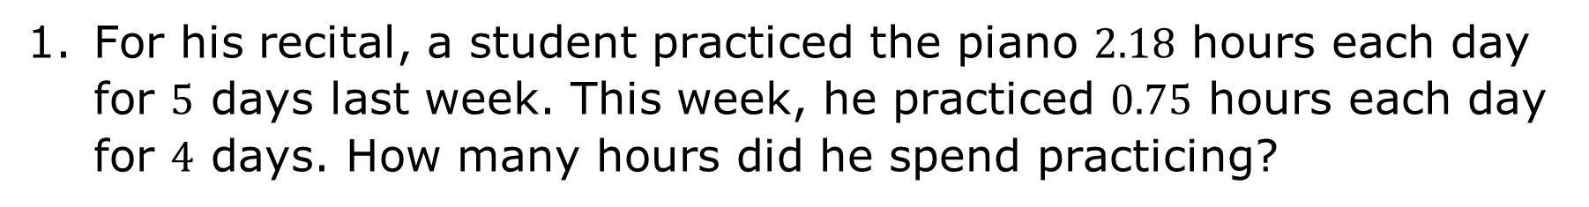
3.8.2 Guided Instruction: Three-Step Rational Problems
For his recital, a student practiced the piano $2.18$ hours each day for $5$ days last week. This week, he practiced $0.75$ hours each day for $4$ days. How many hours did he spend practicing?
volume 1, pg. 124

Slide 9
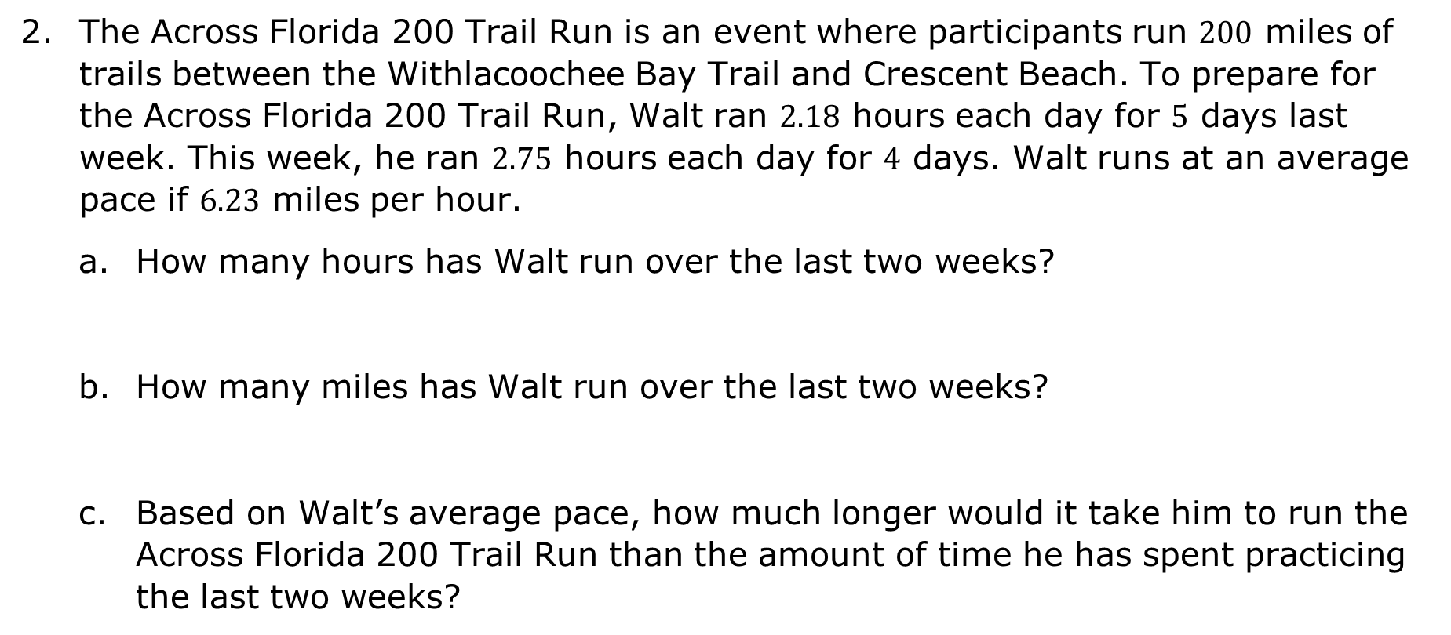
The Across Florida 200 Trail Run is an event where participants run $200$ miles of trails between the Withlacoochee Bay Trail and Crescent Beach. To prepare for the Across Florida 200 Trail Run, Walt ran $2.18$ hours each day for $5$ days last week. This week, he ran $2.75$ hours each day for $4$ days. Walt runs at an average pace if $6.23$ miles per hour.
How many hours has Walt run over the last two weeks?
How many miles has Walt run over the last two weeks?
Based on Walt’s average pace, how much longer would it take him to run the Across Florida 200 Trail Run than the amount of time he has spent practicing the last two weeks?
volume 1, pg. 125

Slide 10
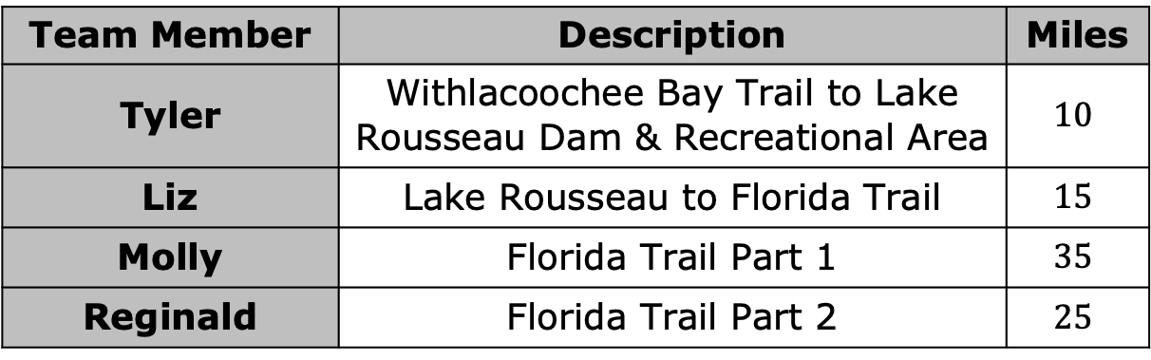
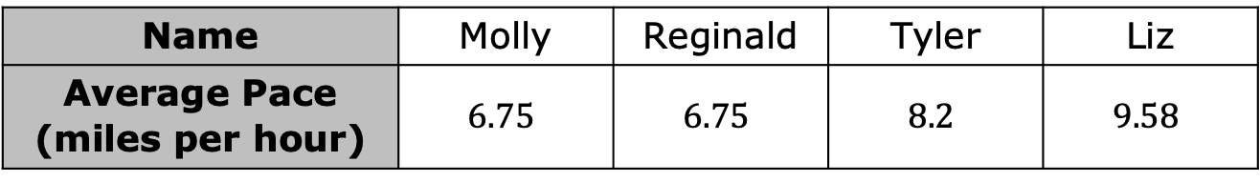
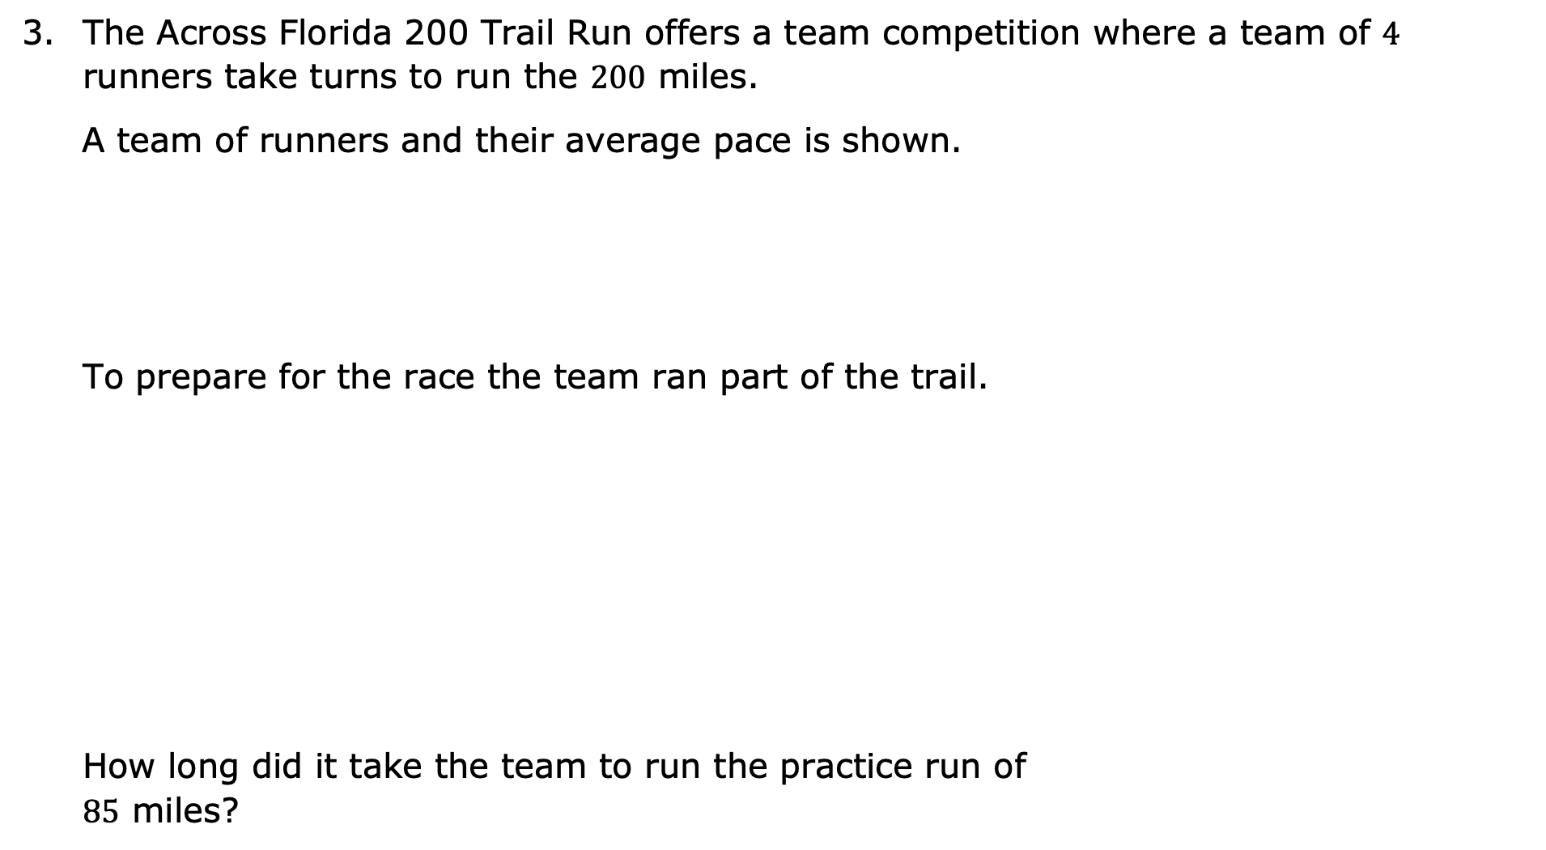
The Across Florida 200 Trail Run offers a team competition where a team of $4$ runners take turns to run the $200$ miles.
A team of runners and their average pace is shown.
To prepare for the race the team ran part of the trail.
How long did it take the team to run the practice run of $85$ miles?
Name | Molly | Reginald | Tyler | Liz
Average Pace (miles per hour) | $$6.75$$ | $$6.75$$ | $$8.2$$ | $$9.58$$
Team Member | Description | Miles
Tyler | Withlacoochee Bay Trail to Lake Rousseau Dam & Recreational Area | $$10$$
Liz | Lake Rousseau to Florida Trail | $$15$$
Molly | Florida Trail Part 1 | $$35$$
Reginald | Florida Trail Part 2 | $$25$$
volume 1, pg. 125

Slide 11

Your Turn
volume 1, pg. 126

Slide 12
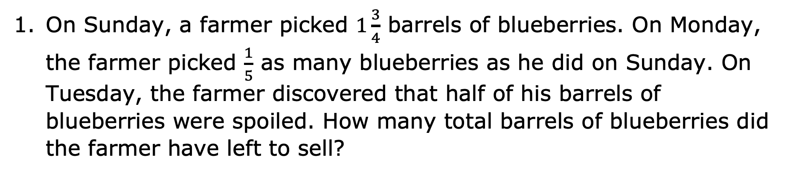
3.8.3 Your Turn!
On Sunday, a farmer picked $1\frac{3}{4}$ barrels of blueberries. On Monday, the farmer picked $\frac{1}{5}$ as many blueberries as he did on Sunday. On Tuesday, the farmer discovered that half of his barrels of blueberries were spoiled. How many total barrels of blueberries did the farmer have left to sell?
volume 1, pg. 126

Slide 13
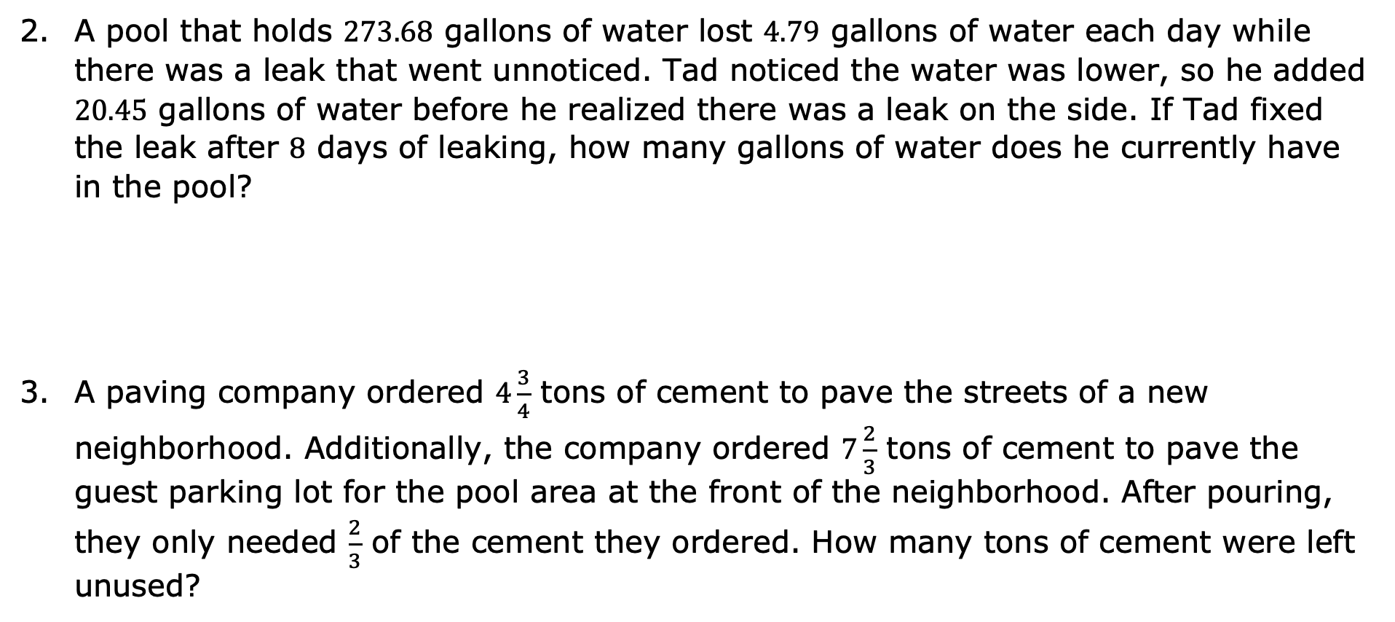
A pool that holds $273.68$ gallons of water lost $4.79$ gallons of water each day while there was a leak that went unnoticed. Tad noticed the water was lower, so he added $20.45$ gallons of water before he realized there was a leak on the side. If Tad fixed the leak after $8$ days of leaking, how many gallons of water does he currently have in the pool?
A paving company ordered $4\frac{3}{4}$ tons of cement to pave the streets of a new neighborhood. Additionally, the company ordered $7\frac{2}{3}$ tons of cement to pave the guest parking lot for the pool area at the front of the neighborhood. After pouring, they only needed $\frac{2}{3}$ of the cement they ordered. How many tons of cement were left unused?
volume 1, pg. 126

Slide 14
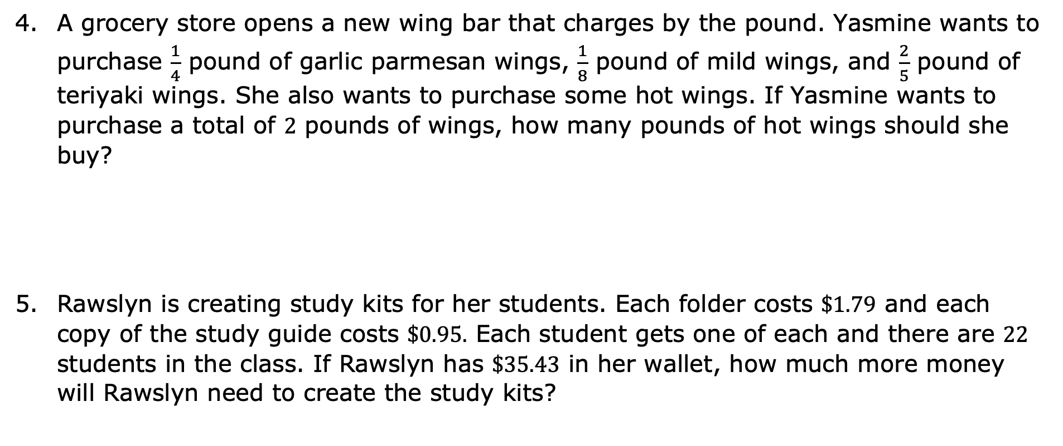
A grocery store opens a new wing bar that charges by the pound. Yasmine wants to purchase $\frac{1}{4}$ pound of garlic parmesan wings, $\frac{1}{8}$ pound of mild wings, and $\frac{2}{5}$ pound of teriyaki wings. She also wants to purchase some hot wings. If Yasmine wants to purchase a total of $2$ pounds of wings, how many pounds of hot wings should she buy?
Rawslyn is creating study kits for her students. Each folder costs $\$1.79$ and each copy of the study guide costs $\$0.95$. Each student gets one of each and there are $22$ students in the class. If Rawslyn has $\$35.43$ in her wallet, how much more money will Rawslyn need to create the study kits?
volume 1, pg. 126

Slide 15

Wrap-Up
volume 1, pg. 127

Slide 16
3.8.4 Wrap-Up: Cool Down
For each statement, write whether you agree with it, disagree with it, or are unsure.
Statement | Agree/Disagree/Unsure
The more digits a number has, the larger it is.
When you add two positive decimals together, the value is always larger.
To add fractions, their denominators must be the same.
The product of two fractions is always a larger number.
When you put a zero on the end of any number, it makes it larger.
volume 1, pg. 127

